Slide 1
Crimes and accidents in toronto
Tigran
Sue
Dian
Dalia

Slide 2
Why Crime and Accidents(ksi)?
Crime
Accidents
Critical in effective crime reduction in a city.
Helps decision making to implement data driven strategies like hotspot policing, problem oriented policing, and intelligence-led policing etc.
Helps us understand the relationship between various criminogenic factors or major crime indicators.
Motor vehicle accidents remain a leading cause of death for young people in Canada.
Helps identifying accident hot spots and thus in effective road safety planning.
Helps identifying the root cause so as to have preventative measures for future strategic planning.

Slide 3
Questions
What are the most common types of crime in toronto?
Which neighborhoods experience the highest crime rates?
How do crime rates fluctuate over time?
How does the income level in a neighborhood affect crime rates?
How does the education level in a neighborhood affect crime rates?
Which areas are most prone to traffic accidents?
How did the number of traffic accidents change over time?
Find the number of fatal and non fatal accidents over the years.

Slide 4
DATA Sources
TORONTO POLICE APIS
MCI - MAJOR CRIME INDICATORS
ARGUMENTS FOR MONTH AND YEAR TO GET AROUND 2000-RECORD LIMIT
KSI - TRAFFIC INCIDENTS
Homicide data API, Toronto Police
STATS CANADA CENSUS API
ARGUMENTS FOR GEOCODE AND TOPIC
MAPBOX API
ADDITIONAL DATASETS
NEIGHBORHOODS-TRACTS CONVERSION CSV

Slide 5
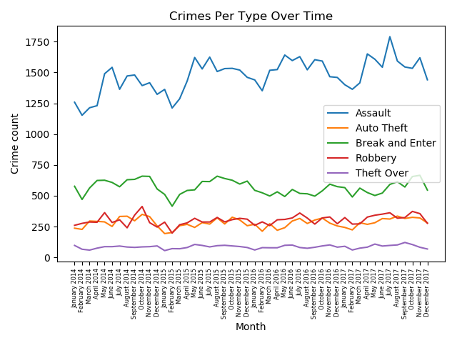
MOST COMMON CRIME TYPES

Slide 6
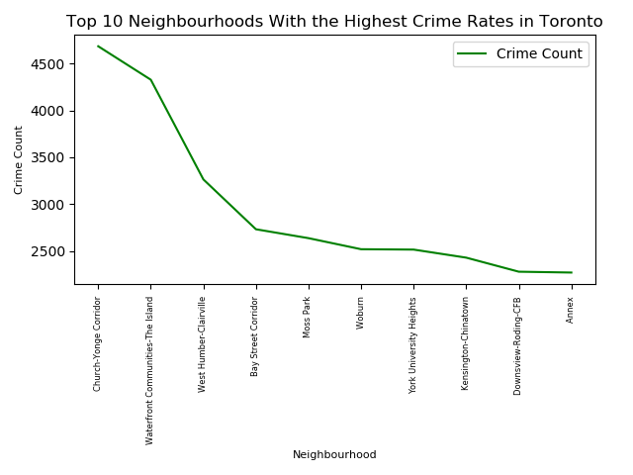
Top 10 Neighborhoods With the Highest Crime Rates in Toronto

Slide 7
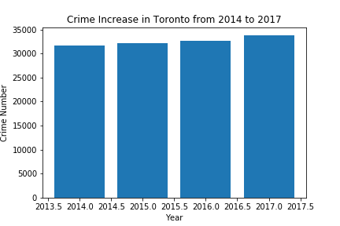
Crime Increase

Slide 8
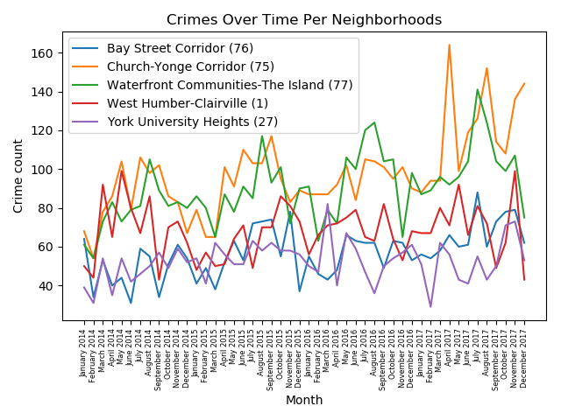
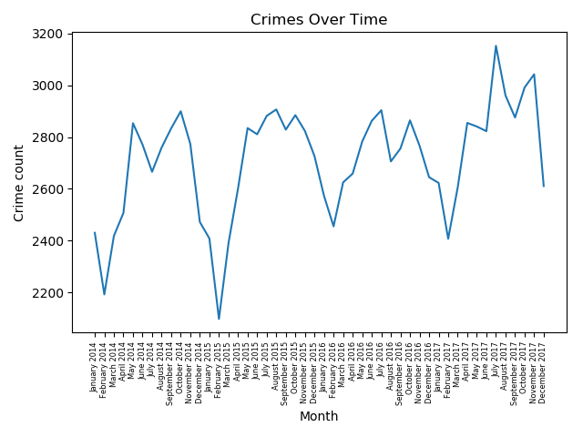
CRIMES OVER TIME

Slide 9
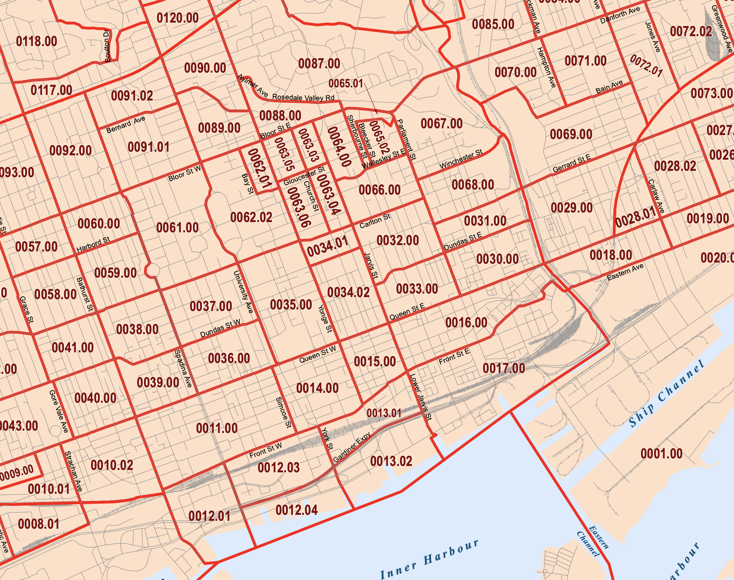
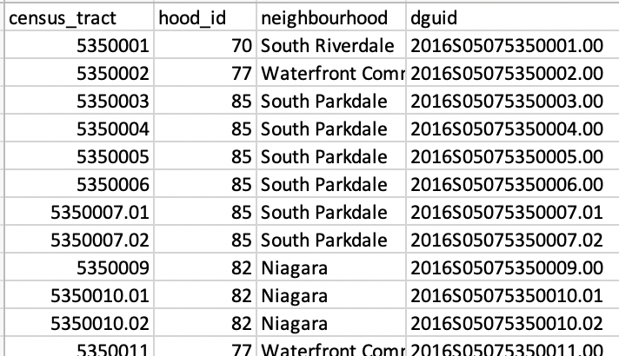
CRIMES VS INCOME and education
POLICE API
ALL INCIDENTS
W/ NEIGHBORHOOD ID
CENSUS API
PULL DATA PER GEOCODE (CENSUS TRACT)
?
https://www12.statcan.gc.ca/rest/census-recensement/ CPR2016.json?lang=E&dguid={dguid}&topic=7

Slide 10
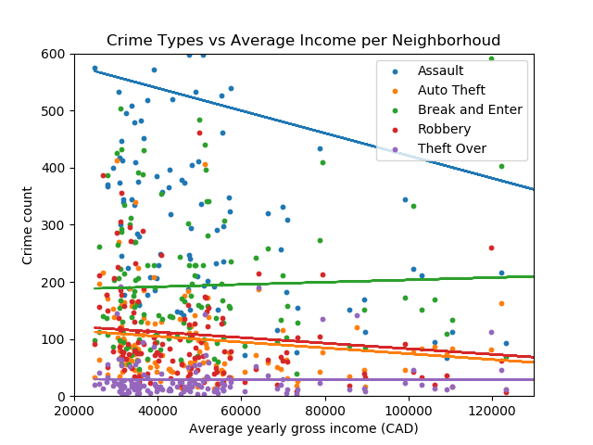
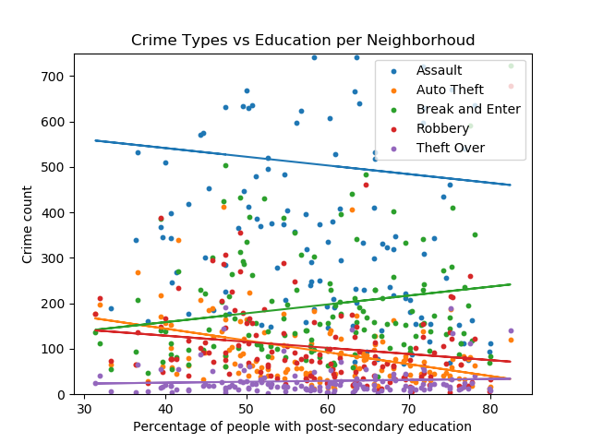
CRIMES VS INCOME AND EDUCATION

Slide 11
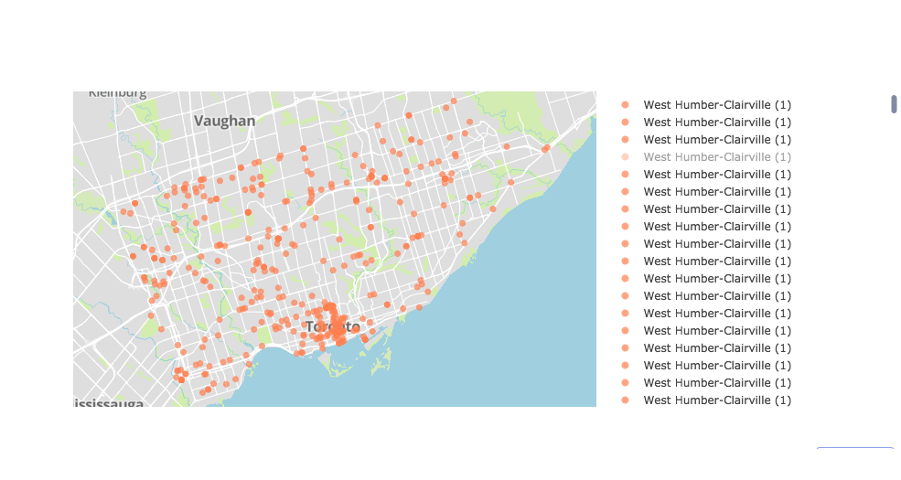
Toronto area Commercial Theft spots

Slide 12
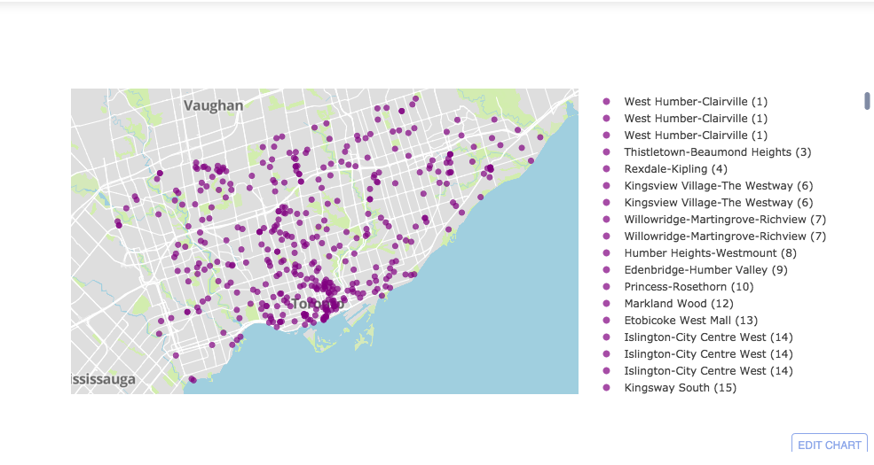
Indoor Thefts per neighborhoods

Slide 13
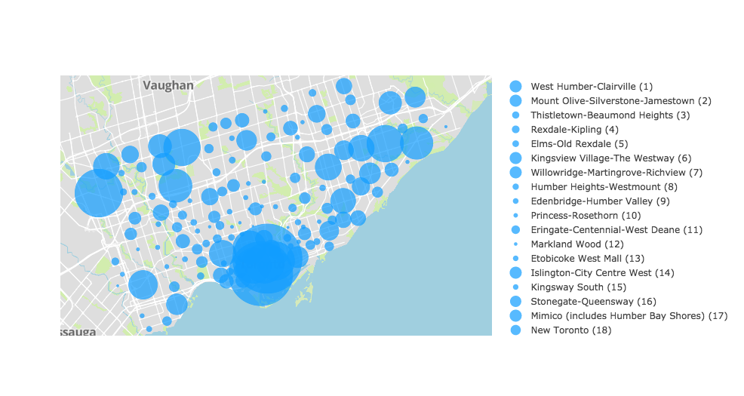
Toronto Crime hotspots

Slide 14
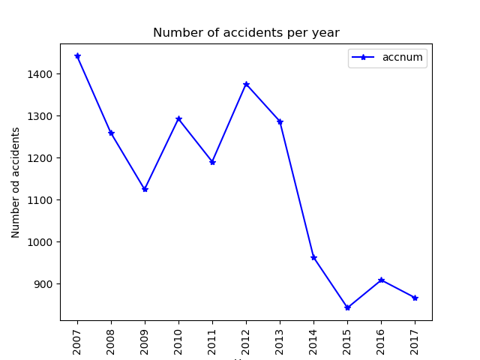
Accidents Timeline
Steep decrease in number since 2012.

Slide 15
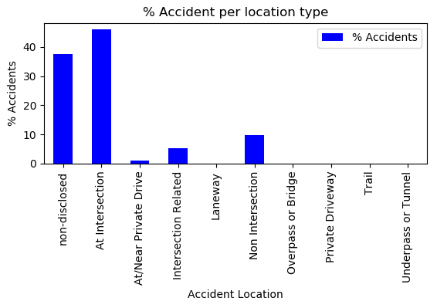
Most favorite location type for accidents
Intersection is the key

Slide 16
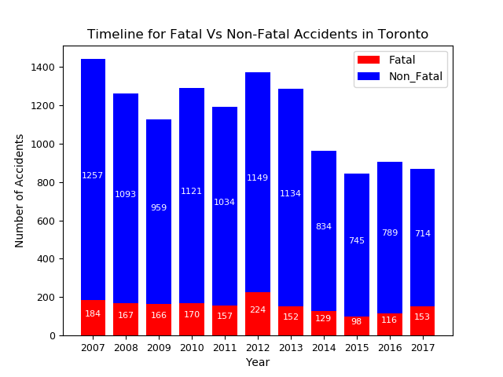
Fatal Vs Non-Fatal

Slide 17
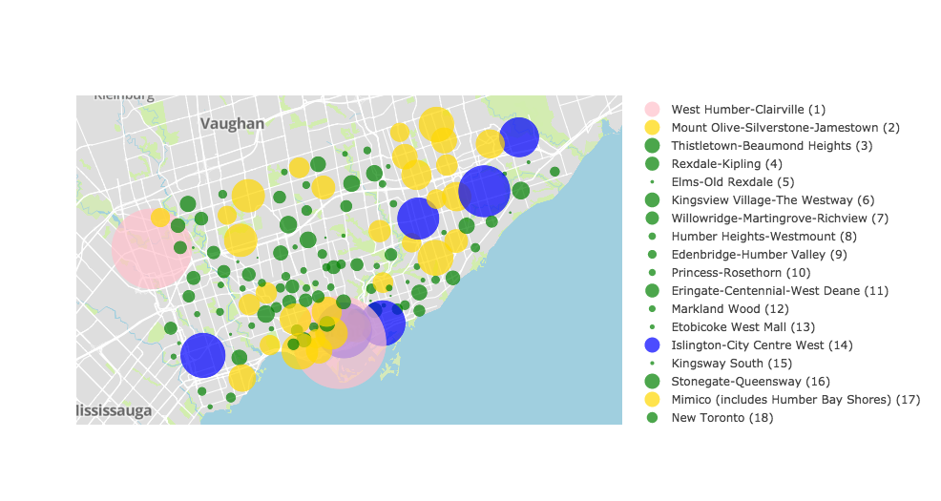
Major collision hotspot in Toronto area

Slide 18
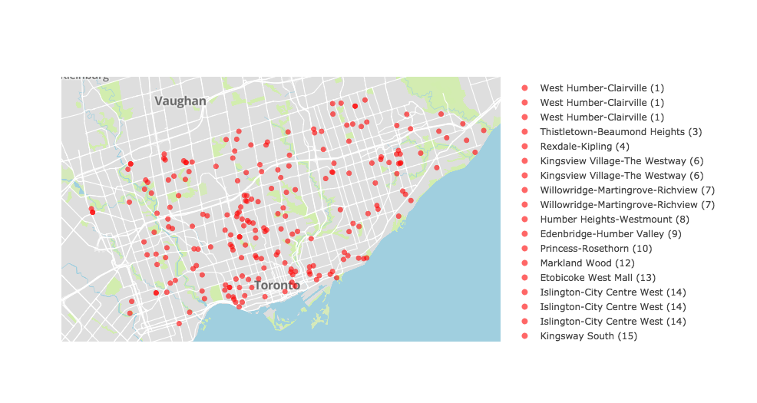
House thefts per neighborhoods

Slide 19
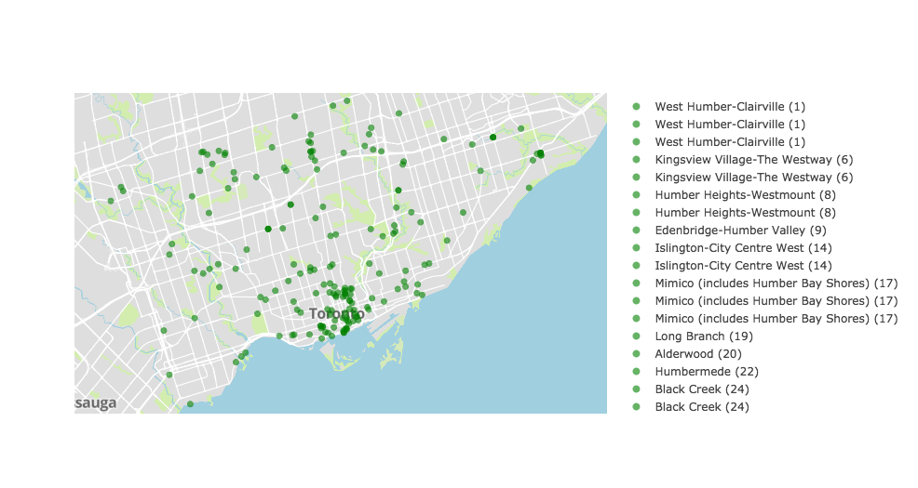
Apartment thefts per neighborhoods

Slide 20
Conclusion
Assault is the most common crime indicator in the city followed by break and enter.
The assault counts profile shows a slow increase in 2017, while other indicators remain at same level.
Top three neighborhoods with highest crime rates are Church-Young corridor, Waterfront communities island, and west humber Clareville respectively.
Increased crime counts are reported in the low income group(20000 to 60000) area.
Top three accident prone neighborhoods in Toronto are Waterfront communities, West Humber-Clairville and Bay street Corridor respectively.
Steep reduction in accidents was observed since 2012.
Intersections are considered the most accident prone location types in Toronto.

Slide 21
Discussion
STATS CANADA DATA IS FOR 2015 ONLY, POLICE DATA IS 2014-2017
More data related to major actions/project undertaken by Toronto city can be explored to know the reasons behind steep fall in accident numbers.
correlation analysis with traffic density, and weather data can help understand their affect of traffic collissions.

